Slide 1
Python: If/Elif/Else
Ms Sastre

Slide 2

Choices
If I go through Door A, I will be in the Kitchen.
If I go through Door B, I will be in the living room.
Do this or else!

Slide 3
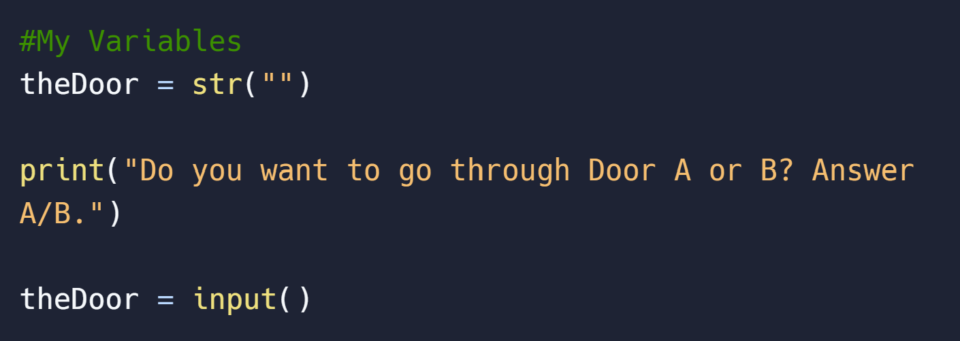
Declare your Variables!
Make sure to also suggest the input you need.

Slide 4
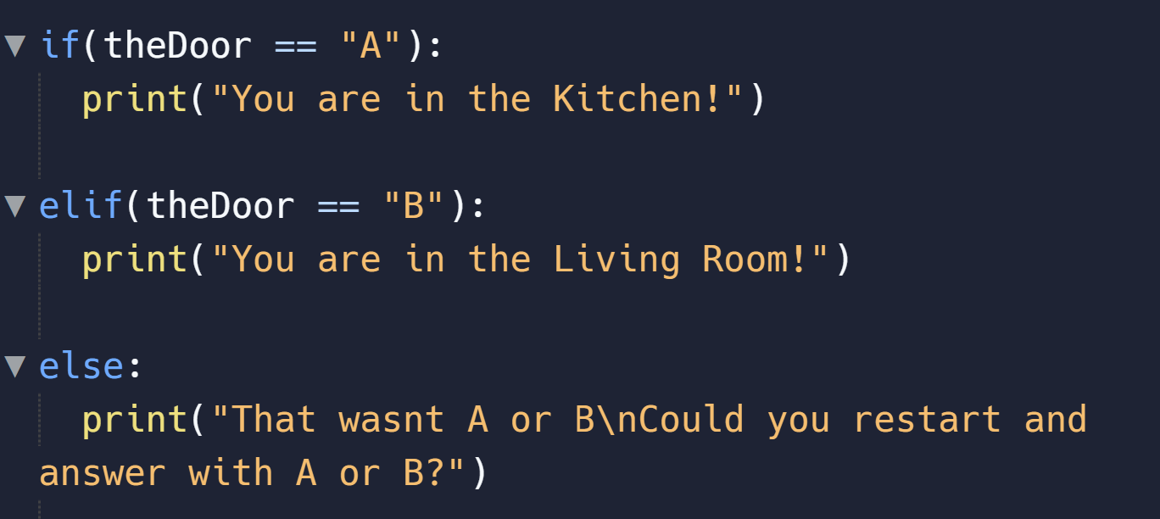
Python If,Elif,Else

Slide 5
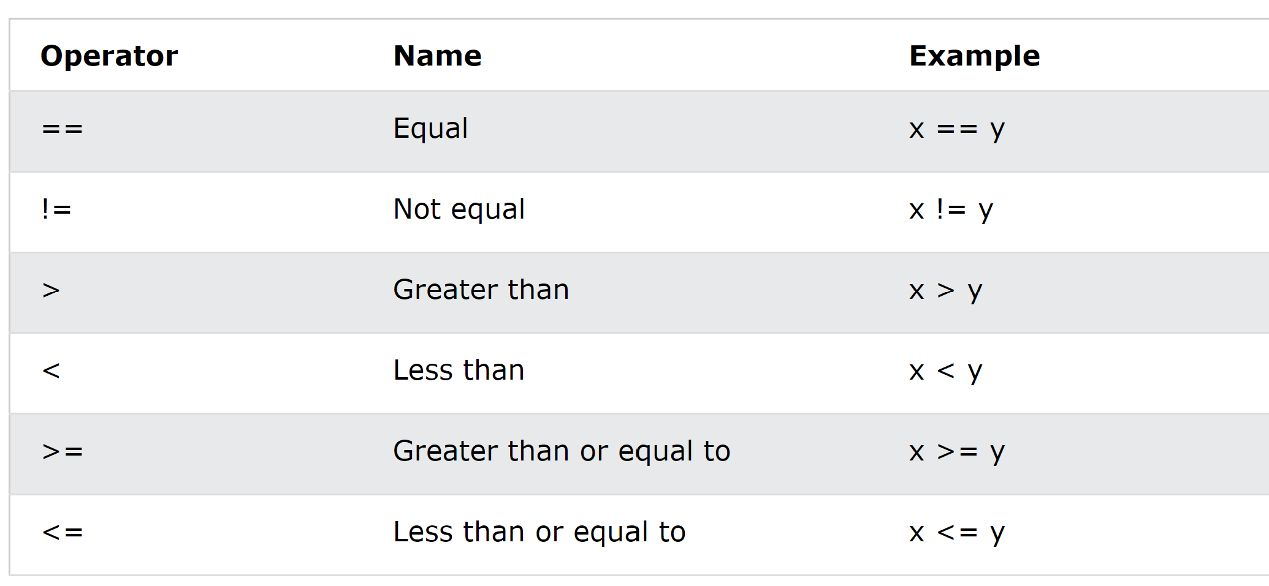
Operators you can use:

Slide 6
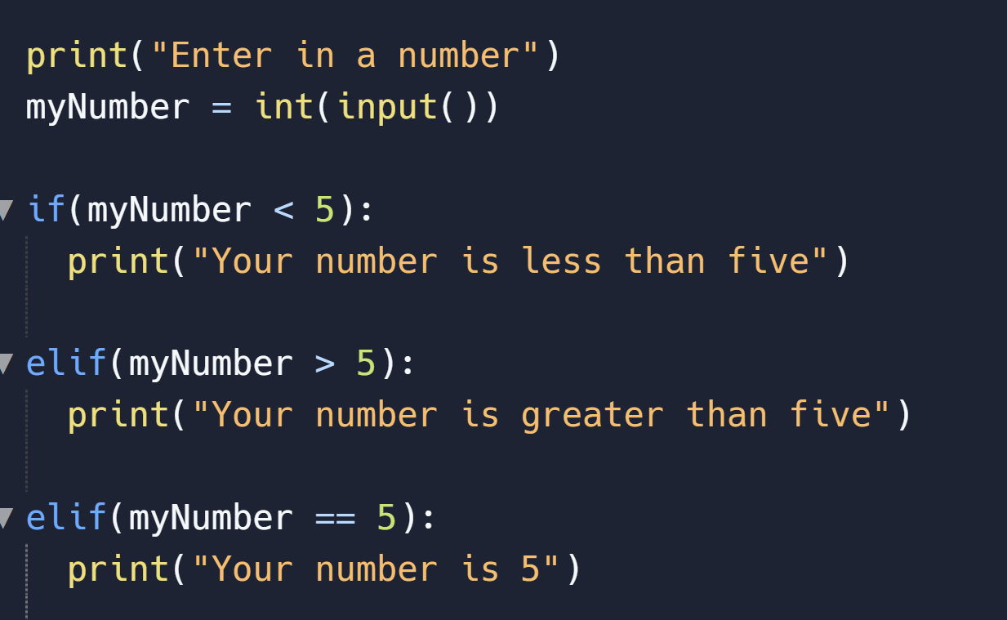
Beware using numbers
Every input is read as a string
You need to parse the input using int()
Integers do not need quotes to work “ ” that’s only for strings.

Slide 7

Lets Code!
https://replit.com/

